Slide 1
Fundamentals of Global Positioning System (GPS) | Global Navigation Satellite System(GNSS)

Slide 2
GPS versus GNSS
GPS (Global Positioning System) is a satellite based system that provides navigation, and timing services built and implemented by United States of America. It was started in 1973 and fully implemented in 1995)
Since then many other countries have implemented or are in the process of implementing their own satellite based navigation and timing services globally and regionally. Now, such systems are jointly referred as Global Navigation Satellite System(GNSS).

Slide 3
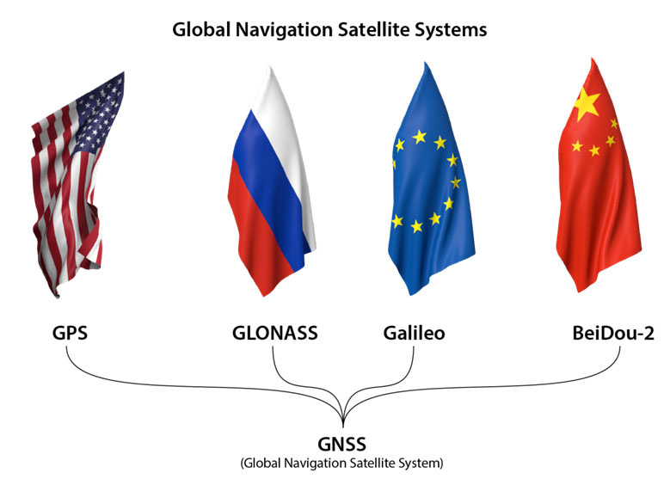
Global Navigation satellite Systems (GNSS)

Slide 4
GNSS
Global Navigation Satellite System (GNSS) is a system of navigating/identifying a position of an object on the surface of earth (no matter whether at the rest or in motion) with the help of earth orbiting satellite.
It was introduced to support a Global positioning and navigation system as it was difficult by the traditional Geodetic/ Astronomic systems

Slide 5
Advantages
A global coverage
Fast and reliable positioning and navigation data
Without relying on weather/ meteorological condition

Slide 6
Working Principle

Slide 7
Working Principle
The working principle of GNSS is:
Position of a unknown object can be identified by measuring range/distance of the object from at least four known position, a well known principle of trilateration in traditional surveying
The distance from satellite to earth is calculated by using the relationship of velocity of light signal and time taken to reach the earth
In GNSS, although geometrically 3 known positions (and range) of satellites are enough, in actuality we require atleast 4 known positions (and range) from satellites to user to identify the unknown position on (or above) the earth surface.

Slide 8
Working principle
GPS is primarily a navigation system.
Based on principle of Trilateration
The fundamental navigation principle is based on the measurement of so-called pseudoranges between the user and satellites.
GPS uses the one-way ranging technique
Starting from the known satellite coordinates in a suitable reference frame the coordinates of the user antenna can be determined.
From the geometrical point of view three range measurements (distance from 3 satellites) are sufficient. But in actuality four range measurements (distance from 4 satellites) is required.

Slide 9
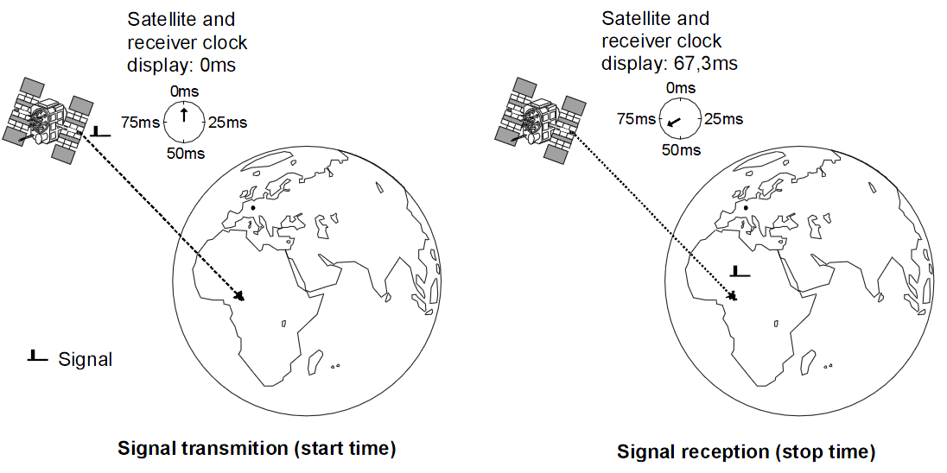
Working principle
The distance S to the satellite can be determined by using the known transit time τ:
distance = travel time • the speed of light
S = τ•c

Slide 10
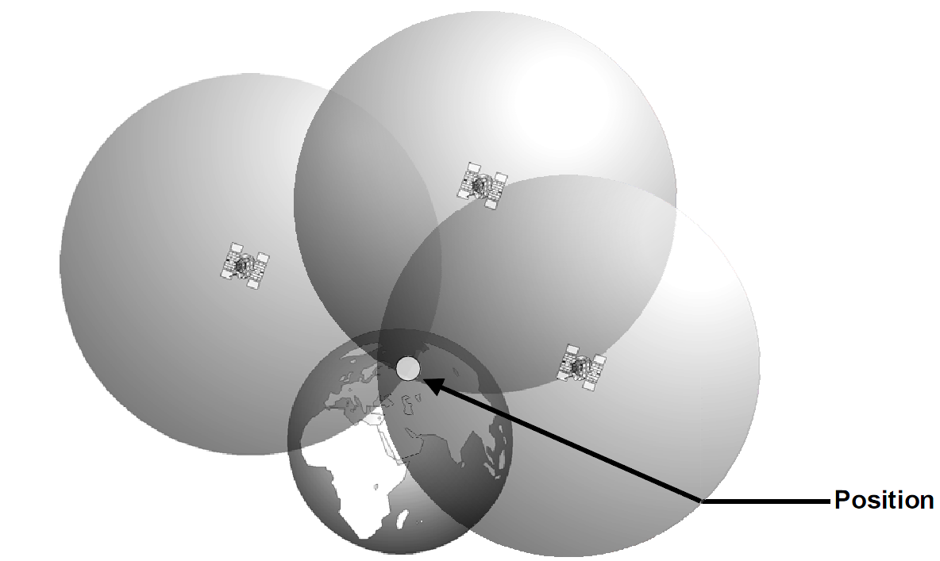
Working principle
In principle(geometrically), three satellites are enough to fix a position on the earth surface

Slide 11
Working principle
We have been assuming up until now that it has been possible to measure signal transit time precisely.
But the clocks may have errors, especially the clocks at the receivers end are not exactly synchronised with the satellite clocks.
This synchronization error is the reason for the term “pseudorange”
For the receiver to measure time precisely a highly accurate, synchronised clock is needed.
If the transit time(time for signal to reach user from satellite) is out by just 1 μs this produces a positional error of 300m.

Slide 12
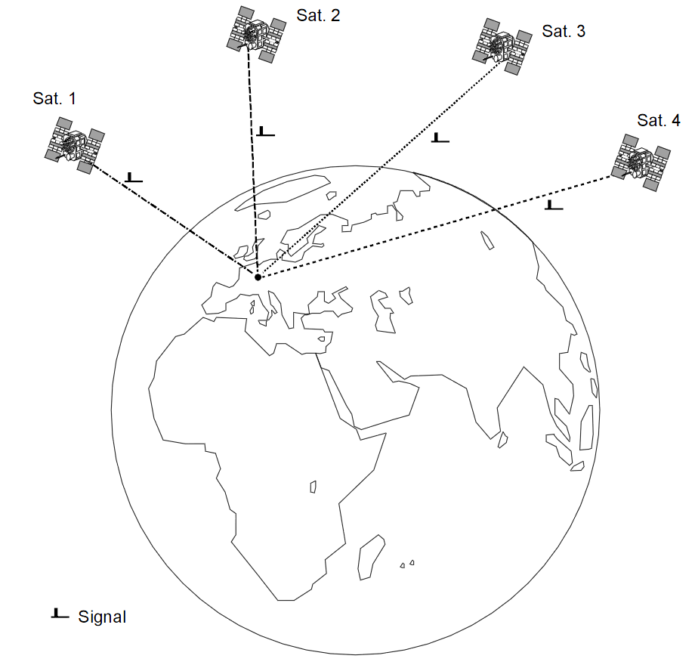
Working principle
To solve the problem, we can use a well known mathematical solution of equations
If N variables are unknown, we need N independent equations.
If the time measurement is accompanied by a constant unknown error, we will have four unknown variables in 3-D space:
Longitude (X)
Latitude (Y)
Height (Z)
time error (Δt)
It therefore follows that in three-dimensional space four satellites are needed to determine a position.

Slide 13
Working principle

Slide 14
GPS
In order to understand the GNSS components, we consider only GPS as an example.

Slide 15
Components of GPS
The Global Positioning System (GPS) comprises three segments
The space segment (all functional satellites)
The control segment (all ground stations involved in the monitoring of the system: master control station, monitor stations, and ground control stations)
The user segment (all civil and military GPS users)

Slide 16
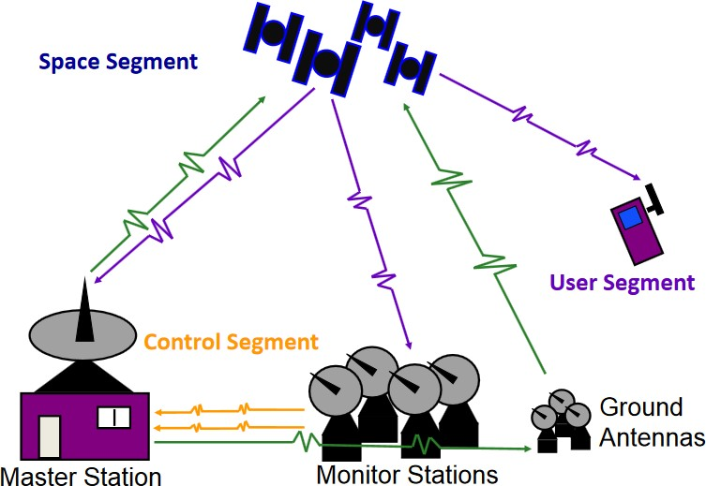
Three components of GPS

Slide 17
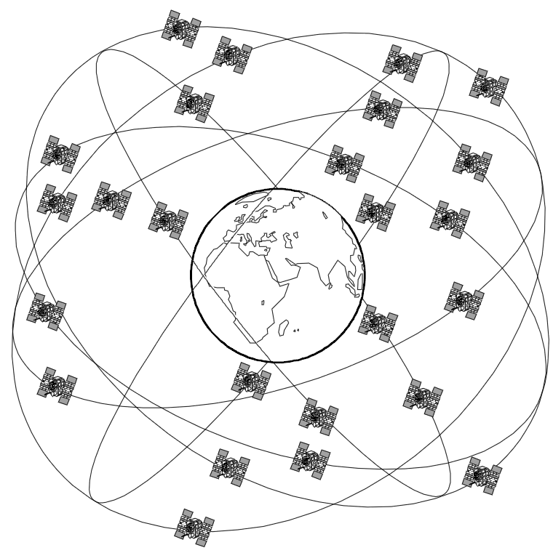
Space Segment

Slide 18
Space Segment
The space segment currently consists of at least 24(baseline constellation) satellites
6 different Orbital planes (four to five satellites per plane).
They orbit at a height of 20,180 km above the Earth’s surface
They are inclined at 55° to the equator.
Any one satellite completes its orbit in around 12 hours. (11 hours and 28 minutes)

Slide 19
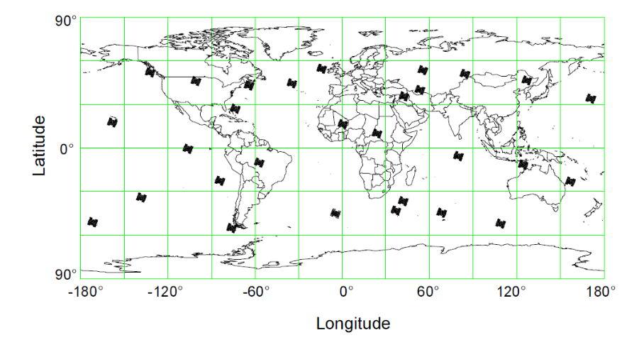
Space Segment

Slide 20
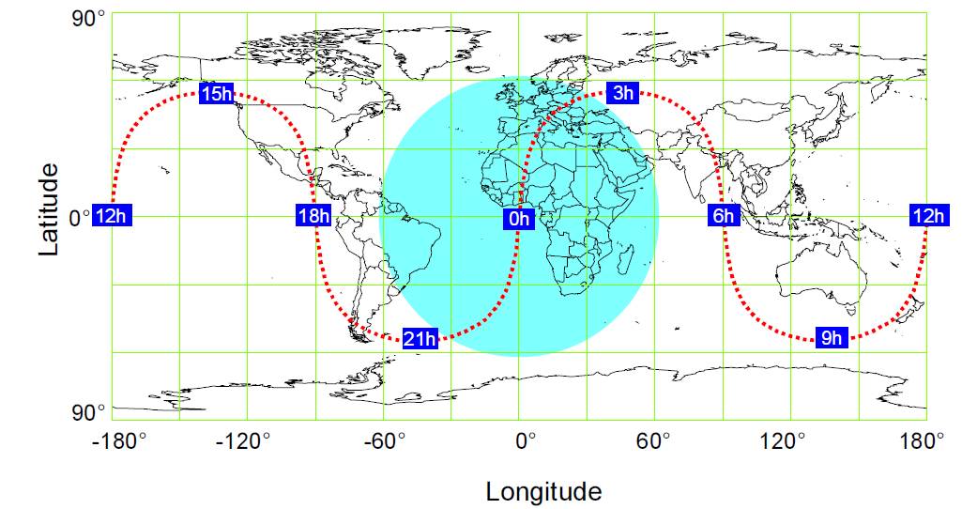
Ground track of a satellite

Slide 21
Space Segment
The arrangement of satellites in the full constellation is called as the baseline constellation
The orbital position of each satellite in one of the six orbital planes A to F is indicated by its plane position number, also named slot.
Four slots are assigned to each plane.
Six additional slots, A5 through F5, are provided on the basis of need for active spares.
The separation in right ascension between two orbital planes is 60◦.

Slide 22
Space Segments
Although the baseline constellation includes 24 satellites, the number of active satellites on orbit may vary due to failures, launches, or maintenance requirements,
Since 1995 no. of satellites in the constellation has already exceeded 24.
On January 1, 2003, the constellation comprised 28 satellites.
Now there are 32 satellites in baseline constellation of NAVSTAR GPS.
With the augmented constellation, most users will have six to eight, or at times even more, satellites in view instead of the minimum of four satellites.

Slide 23
Control Segment
The tasks of the Control Segment are to
continuously monitor and control the satellite system,
determine the GPS system time,
predict the satellite ephemerides and the behavior of the satellite clocks,
periodically update the navigation message for each particular satellite, and
command small maneuvers to maintain orbit, or relocate to substitute an unhealthy satellite.

Slide 24
Control Segment
Within the Control Segment are the Master Control Station (MCS), several unmanned monitor stations (MS) located around the world, and ground antennas (GA) for uploading data to the satellites.
The current Operational Control Segment (OCS) includes a master control station, an alternate master control station, 11 command and control antennas, and 16 monitoring sites.

Slide 25
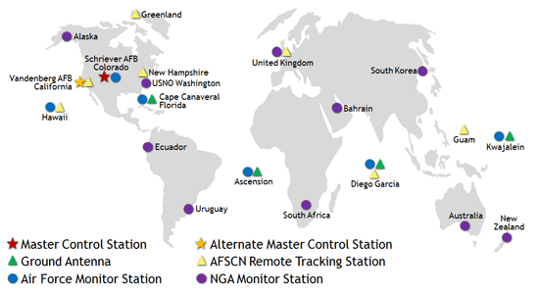
Control Segment

Slide 26
User Segment
Receivers on ground stations,
navigation systems in aero plane, car, ships, cycle

Slide 27
User Segment
The signals transmitted by the satellites take approx. 67 milliseconds to reach a receiver. As the signals travel at the speed of light, their exact transit time depends on the distance between the satellites and the user.
Four different signals are generated in the receiver having the same structure as those received from the 4 satellites.
By synchronising the signals generated in the receiver with those from the satellites, the four satellite signal time shifts Δt are measured.
The measured time shifts Δt of all 4 satellite signals are used to determine signal transit time.

Slide 28
Application
Science and technology/Engineering
Commerce and industry
Forestry
Agriculture
Communication Technology
Navigation
Tourism/ Sport
Military
Time measurement
Research

Slide 29
Error Sources in GNSS

Slide 30
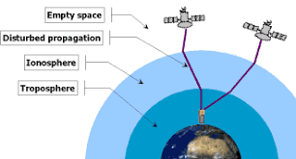
How far does the signals have to travel from GPS satellites to reach to the receiver?

Slide 31
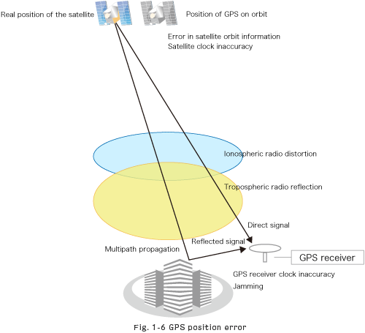
Error Sources in GNSS
d_{ρ}
Satellite Clocks (dt)
Orbit Errors d_{ρ}
Ionospheric Delay d_{ion}
Tropospheric Delay d_{trop}
Receiver Noise ε_{ρ}
Multipath ε_{mρ}
dt
d_{ion}
d_{trop}
ε_{mρ}
ε_{ρ}

Slide 32
Error Budget
Error budget is the list of potential ranging error sources and their magnitude.
Error Sources | Standard GPS | Differential GPS
Satellite Clocks | 1.5 | 0
Orbit Errors | 2.5 | 0
Ionosphere | 5.0 | 0.4
Troposphere | 0.5 | 0.2
Receiver Noise | 0.3 | 0.3
Multipath | 0.6 | 0.6

Slide 33
Error Sources in GNSS
Satellite Clocks
Source of satellite clock errors:
Satellite Clock Drift
Although there are 3 to 4 cesium/rubidium based accurate clocks in each satellite, these drift with time and should be adjusted.
Clock corrections are done in the following way (for GPS):
The Master Control Station in Colorado Springs gathers GPS satellite’s data from monitoring stations around the world.
This is processed and uploaded back to satellite.
The satellites transmit these clock corrections as Navigation messages.

Slide 34
Error Sources in GNSS
Assuming all clocks in GNSS satellites had an error of 1 microsecond (which was not corrected), what would be the range error in between the receiver and the satellite?

Slide 35
Error Sources in GNSS
b. Orbit Error
GNSS satellites travel in very precise, well known orbits.
But they still vary by small amount.
The GNSS ground control system continually monitors the satellite orbit.
When the satellite orbit changes, the ground control system sends a correction to the satellites and the satellite ephemeris is updated.
What can you do to correct these as a surveyor?
Use precise ephemeris
Use differential GNSS

Slide 36
Error Sources in GNSS
c. Ionospheric Delay
The ionosphere is the layer of atmosphere between 80 km and 600 km above the earth. This layer contains electrically charged particles called ions. These ions delay the satellite signals and can cause a significant amount of satellite position error (Typically ±5 metres, but can be more during periods of high ionospheric activity).
Ionospheric delay varies with solar activity, time of year, season, time of day and location. This makes it very difficult to predict how much ionospheric delay is impacting the calculated position.
How to correct ?
Different frequencies are affected in different way. So, we can use dual bands L1 and L2 to find out the Ionospheric delay.
Ionospheric conditions are very similar within a local area, so the base station and rover receivers experience very similar delay. This allows Differential GNSS and RTK systems to compensate for ionospheric delay.

Slide 37
Error Sources in GNSS
d. Tropospheric Delay
The troposphere is the layer of atmosphere closest to the surface of the Earth.
Variations in tropospheric delay are caused by the changing humidity, temperature and atmospheric pressure in the troposphere.
How to correct ?
Use tropospheric models to estimate the amount of error caused by tropospheric delay.
Since tropospheric conditions are very similar within a local area, the base station and rover receivers experience very similar tropospheric delay. This allows Differential GNSS and RTK systems to compensate for tropospheric delay.

Slide 38
Error Sources in GNSS
e. Receiver Noise
Receiver noise refers to the position error caused by the GNSS receiver hardware and software. High end GNSS receivers tend to have less receiver noise than lower cost GNSS receivers.

Slide 39
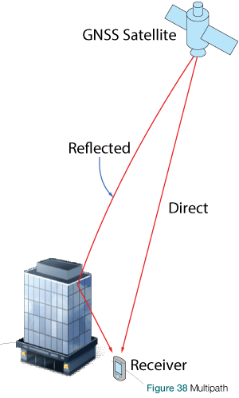
Error Sources in GNSS
f. Multipath
Multipath occurs when a GNSS signal is reflected off an object, such as the wall of a building, to the GNSS antenna. Because the reflected signal travels farther to reach the antenna, the reflected signal arrives at the receiver slightly delayed. This delayed signal can cause the receiver to calculate an incorrect position.
How to correct?
The simplest way to reduce multipath errors is to place the GNSS antenna in a location that is away from the reflective surface.
Long delay multipath errors are typically handled by the GNSS receiver, while short delay multipath errors are handled by the GNSS antenna. Due to the additional technology required to deal with multipath signals, high end GNSS receivers and antennas tend to be better at rejecting multipath errors.

Slide 40
Dilution of Precision
a. Dilution of Precision
Different satellite geometries (the locations of the satellites in view relative to each other and to the receiver) affect the accuracy of receiver’s final position
The effect is quantified as the DOP value, which changes continuously as the satellites move across the sky.
There are several DOP designations in current use :
GDOP : Geometrical DOP(positionin3-D space, incl. time deviation in the solution)
PDOP : Positional DOP(position in 3-Dspace)
HDOP : Horizontal DOP(position on a plane)
VDOP : Vertical DOP (height only)

Slide 41
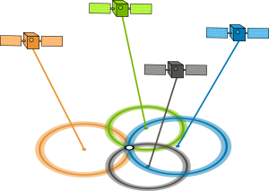
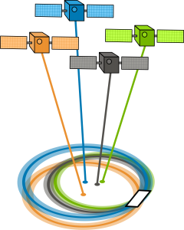
GDOP/PDOP – Geometric/Position Dilution of Precision
From the observer’s point of view, if the satellites are spread apart in the sky, then the GPS receiver has a good GDOP.
But if the satellites are physically close together, then you have poor GDOP. This lowers the quality of your GPS positioning potentially by meters.
Notes:
GDOP (geometric dilution of precision) or PDOP (position dilution of precision) describes error caused by the relative position of the GPS satellites. Basically, the more signals a GPS receiver can “see” (spread apart versus close together), the more precise it can be.

Slide 42
DOP Value | Rating | Description
1 | Ideal | Highest possible confidence level to be used for applications demanding the highest possible precision at all times.
1-2 | Excellent | At this confidence level, positional measurements are considered accurate enough to meet all but the most sensitive applications.
2-5 | Good | Represents a level that marks the minimum appropriate for making accurate decisions. Positional measurements could be used to make reliable in-route navigation suggestions to the user.
5-10 | Moderate | Positional measurements could be used for calculations, but the fix quality could still be improved. A more open view of the sky is recommended.
10-20 | Fair | Represents a low confidence level. Positional measurements should be discarded or used only to indicate a very rough estimate of the current location.
>20 | Poor | At this level, measurements are inaccurate by as much as 300 meters with a 6-meter accurate device (50 DOP × 6 meters) and should be discarded.
Meaning of DOP Values
Notes:
Thus a low DOP value represents a better positional precision due to the wider angular separation between the satellites used to calculate a unit's position.

Slide 43
Pros and cons of GNSS/GPS
Pros
High accuracy.
Global coverage
Works without inter visibility (In the dark, rain, fog etc).
Rapid results.
3 dimensions with one measurement.
No much physical labour is needed
No highly skilled HR is needed for field operation (for processing skill is required)
Multipurpose use
Becomes cheaper in long term use
Cons
Need to see the sky (can’t use it in-house, underground, narrow strip )
Beware height conversions to geoids, operates in WGS 84, so conversions are must
Training is essential for technical facts and their application, though not much for field operation
Not widely available in local areas
Hi tech, sofisticated and expensive instruments and software
Not much awareness among general people and users

Slide 44
Applications of GNSS In Context of Nepal

Slide 45
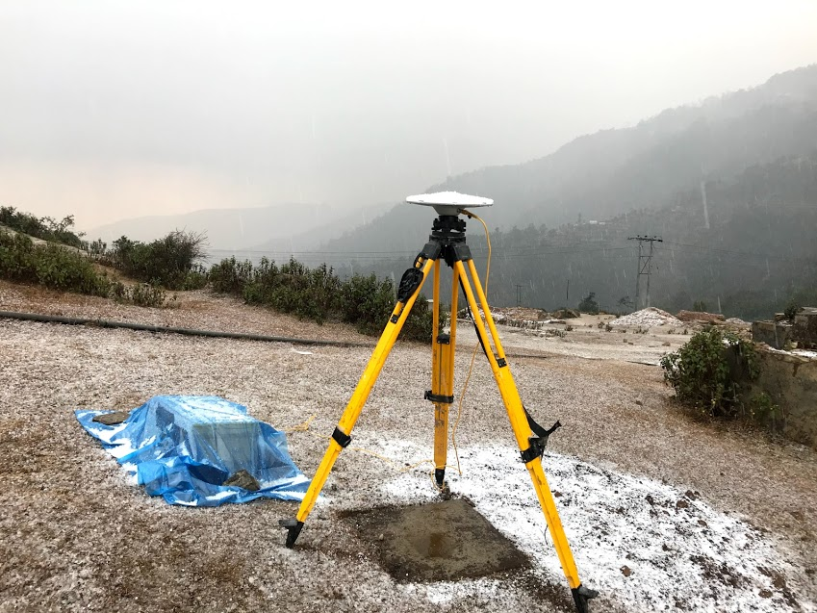
Surveying
The Geodetic Survey Division of Nepal establishes control points using GNSS.
Private sector have started to use GNSS for establishment of control point as well as for detail survey proposes.

Slide 46
Georeferencing Satellite Imagery
The Topographic Survey and Land Use Management Division uses GNSS to georeference satellite imagery.

Slide 47

Vehicle Tracking System
Some governmental institutions, Nepal Police have started using Vehicle Tracking System.
There are also private companies offering vehicle tracking services.

Slide 48
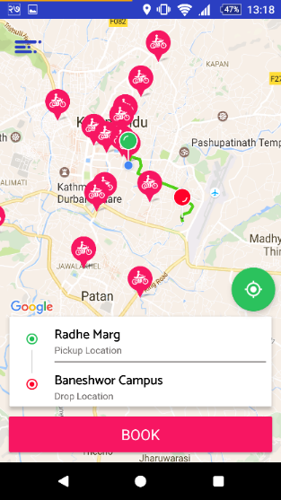

Transportation Services
Companies like Tootle and Pathao use GNSS to track scooters/motorbikes as well as location of customers.

Slide 49
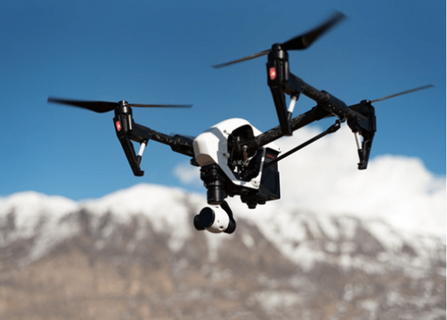
UAV flight
GNSS in UAV allows users to perform automatic flights.

Slide 50
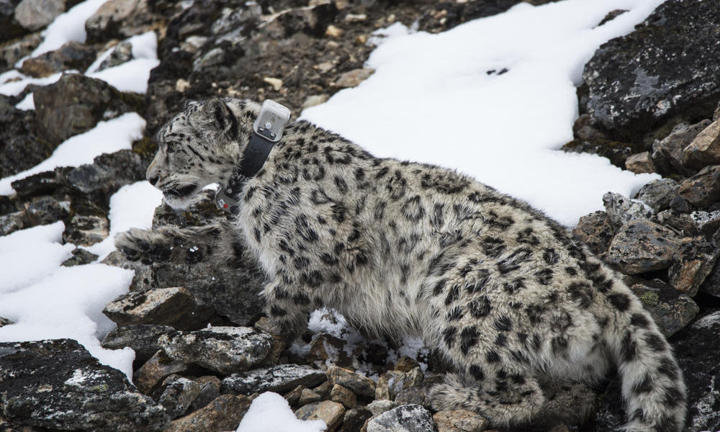
Tracking Wildlife using GPS - collared

Slide 51
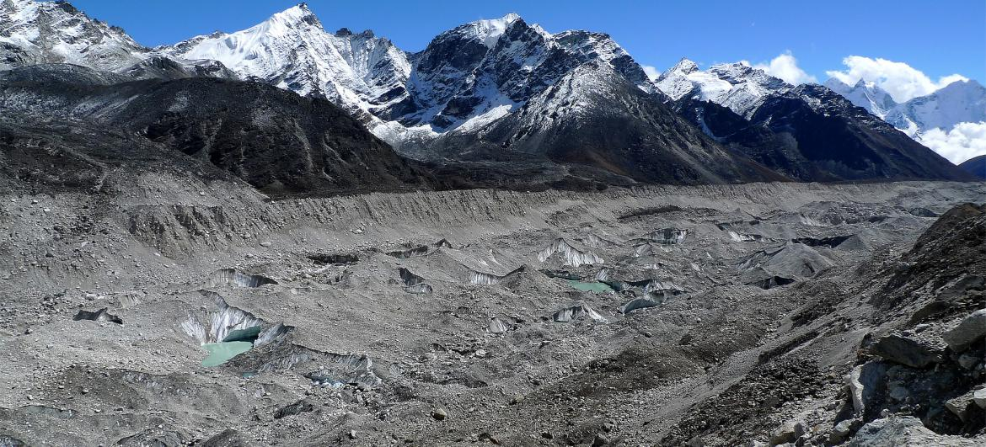
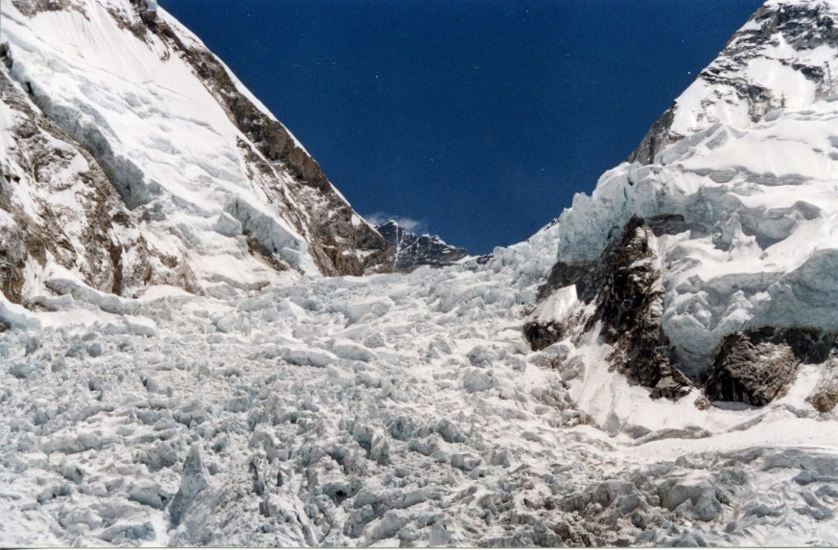
Study of Glaciers
As glaciers are quite sensitive to climate change, it is necessary to perform accurate measurements which is done using GNSS.

Slide 52
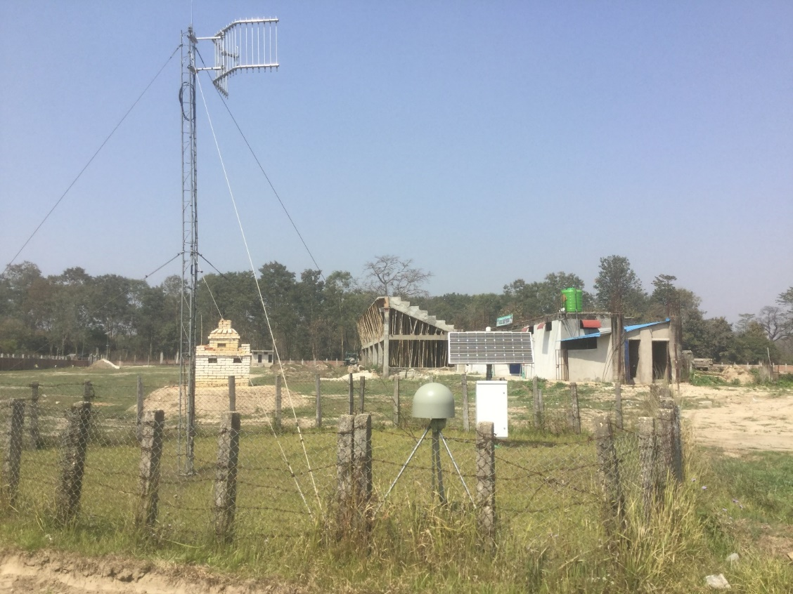
Study of Geodynamics and Earthquake
Large number of CORS stations are established by Department of Mines and Geology in collaboration with international organizations for study of geodynamics and earthquake in Nepal.

Slide 53
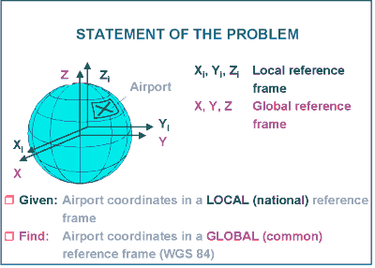
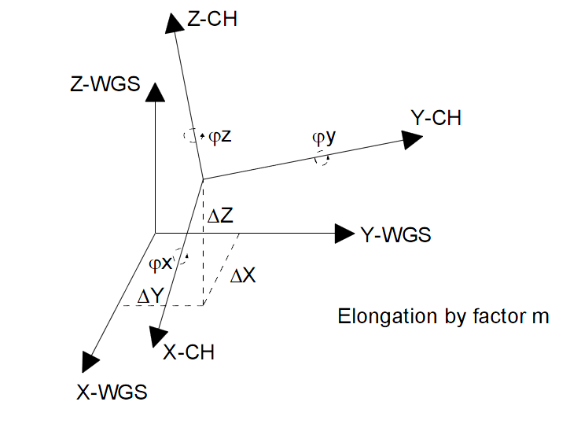
Coordinates from GNSS and Nepal Coordinate System are based on different datum and hence do not match readily. Therefore we need to perform datum transformation.

Slide 54
Field Exercise
Collect some location data using your mobile phones.
Use maps.me app to collect the location.

Slide 55
End of Session

